Slide 1
Data Parallelism: How to Train Deep Learning Models on Multiple GPUs Lab 2, part 1: introduction to Distributed data parallel (DDP)

Slide 2











Training a Neural Network
Multiple GPUs
GPU
$$\hat{y}$$
$$ℒ(\hat{y},y)$$
GPU
$$ℒ(\hat{y},y)$$
$$\hat{y}$$
CPU/GPU
$$W^{[3]}=W^{[3]}− α∗\frac{∂ℒ}{∂W^{[3]}}$$
$$W^{[3]}=W^{[3]}− α∗\frac{∂ℒ}{∂W^{[3]}}$$
W^{[3]}
W^{[3]}
$$W^{[2]}=W^{[2]}− α∗\frac{∂ℒ}{∂W^{[2]}}$$
$$W^{[2]}=W^{[2]}− α∗\frac{∂ℒ}{∂W^{[2]}}$$
W^{[2]}
W^{[2]}
$$W^{[1]}=W^{[1]}− α∗\frac{∂ℒ}{∂W^{[1]}}$$
$$W^{[1]}=W^{[1]}− α∗\frac{∂ℒ}{∂W^{[1]}}$$
W^{[1]}
W^{[1]}
CPU/GPU
CPU/GPU

Slide 3

Meet DDP
Library for distributed DL
Prepackaged into and optimized for PyTorch, an increasingly popular platform among ML engineers and researchers

Slide 4
Using Distributed Data parallel (DDP)

Slide 5
Initialize the process
def setup(global_rank, world_size):
dist.init_process_group(backend="nccl", rank=global_rank, world_size=world_size)

Slide 6
Pin gpu to be used
device = torch.device("cuda:" + str(local_rank))
model = Net().to(device)

Slide 7
Encapsulate model with DDP
model = nn.parallel.DistributedDataParallel(model, device_ids=[local_rank])

Slide 8
Synchronize initial state
Handled internally by DDP across processes and nodes!

Slide 9
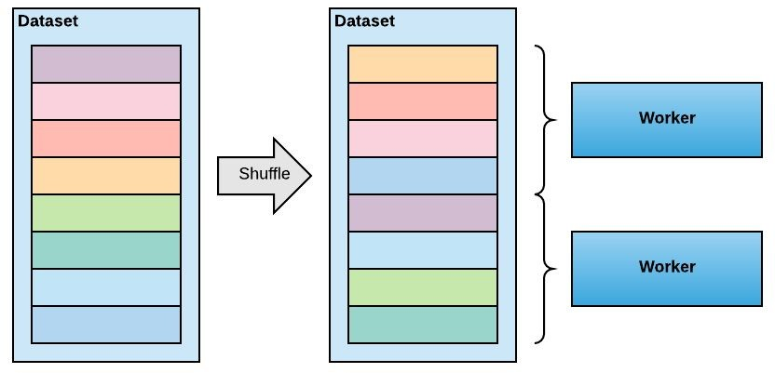
Data partitioning
Shuffle the dataset
Partition records among workers
Train by sequentially reading the partition
After epoch is done, reshuffle and partition again

Slide 10
DATA Partitioning
train_sampler = torch.utils.data.distributed.DistributedSampler(train_set, num_replicas=world_size, rank=global_rank)
train_loader =
torch.utils.data.DataLoader(train_set, batch_size=args.batch_size, sampler=train_sampler)

Slide 11
I/o on only on one worker
download = True if local_rank == 0 else False
if local_rank == 0:
train_set = torchvision.datasets.FashionMNIST("./data", download=download)
--------------------
if global_rank == 0:
print("Epoch = {:2d}: Validation Loss = {:5.3f}, Validation Accuracy = {:5.3f}".format(epoch+1, v_loss, val_accuracy[-1]))

